Slide 1
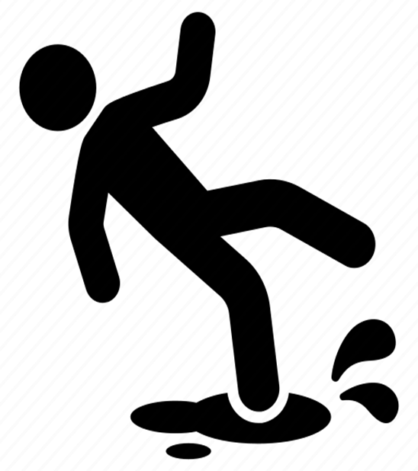
Almost 50% of workplace injuries come from slips, trips, falls and ergonomic issues.
Did you know…
TRIP HAZARDS
Bags underneath desks, rolled up cables, boxes temporarily stored in walkways. A clear walkway at 8AM may not be clear at 10AM.
ERGONOMICS
A monitor that’s too low, a chair that sinks through the day or hours spent leaning forward towards a laptop. Over time, these create strains, fatigue, and long-term issues.
In 2024, the Bureau of Labor Statistic reported 479,480 nonfatal injuries caused by falls, slips, and trips and 568,150 musculoskeletal injuries (sprains, strains, and tears).
DISTRACTIONS WHILE WALKING
Reading emails or Teams messages on the move reduces situational awareness. It only takes one step in the wrong direction to turn a normal task into a near-miss.
The Risks We Overlook:
In an office setting, the biggest risks usually come from the everyday hazards we stop noticing because they feel so familiar.
IMPROPER LIFTING
Grabbing a box of paper, water jug, or office supplies without proper form is one of the most overlooked causes of strains & sprains.
https://www.bls.gov/iif/latest-numbers.htm

